Slide 1
Software Engineering
Dr. Md. Nasim Adnan

Slide 2
Some Software Failures: The Y2K (Year 2000) Bug, circa 1974
Sometime in the early 1970s a computer programmer—let’s suppose his name was Dave—was working on a payroll system for his company. The computer he was using had very little memory for storage, forcing him to conserve every last byte he could. Dave was proud that he could pack his programs more tightly than any of his peers.
One method he used was to shorten dates from their 4-digit format, such as 1973, to a 2-digit format, such as 73. Because his payroll program relied heavily on date processing, Dave could save lots of expensive memory space. He briefly considered the problems that might occur when the current year hit 2000 and his program began doing computations on years such as 00 and 01.

Slide 3
The Y2K (Year 2000) Bug, circa 1974
He knew there would be problems but decided that his program would surely be replaced or updated in 25 years and his immediate tasks were more important than planning for something that far out in time. After all, he had a deadline to meet.
In 1995, Dave’s program was still being used, Dave was retired, and no one knew how to get into the program to check if it was Y2K compliant, let alone how to fix it. It’s estimated that several hundred billion dollars were spent, worldwide, to replace or update computer programs such as Dave’s, to fix potential Year 2000 failures.

Slide 4
Disney’s Lion King, 1994–1995
In the fall of 1994, the Disney company released its first multimedia CD-ROM game for children, The Lion King Animated Storybook.
Although many other companies had been marketing children’s programs for years, this was Disney’s first venture into the market and it was highly promoted and advertised. Sales were huge. It was “the game to buy” for children that holiday season.
What happened, however, was a huge debacle. On December 26, the day after Christmas, Disney’s customer support phones began to ring, and ring, and ring.
Soon the phone support technicians were swamped with calls from angry parents with crying children who couldn’t get the software to work. Numerous stories appeared in newspapers and on TV news.

Slide 5
The USA Star-Wars Program
‘Patriot missile’ was the result of the USA ‘Star Wars’ program. This missile was used for the first time in the Gulf war against the Scud missile of Iraq. Surprisingly, ‘Patriot missiles’ failed many times to hit the targeted Scud missile. One of the failures killed 28 American soldiers in Dhahran, Saudi Arabia.
An investigation team was constituted to identify the cause of failure. The team re-looked at every dimension of the product and found the reason for the failure. The cause of the failure was a software fault. There was a slight timing error in the system’s clock after 14 hours of its operation.
Hence, the tracking system was not accurate after 14 hours of operations and at the time of the Dhahran attack, the system had already operated for more than 100 hours.

Slide 6
Intel Pentium Floating-Point Division Bug, 1994
Enter the following equation into your PC’s calculator: (4195835 / 3145727) * 3145727 – 4195835
If the answer is zero, your computer is just fine. If you get anything else, you have an old Intel Pentium CPU with a floating-point division bug—a software bug burned into a computer chip and reproduced over and over in the manufacturing process.
On October 30, 1994, Dr. Thomas R. Nicely of Lynchburg (Virginia) College traced an unexpected result from one of his experiments to an incorrect answer by a division problem solved on his Pentium PC.

Slide 7
He posted his find on the Internet and soon afterward a firestorm erupted as numerous other people duplicated his problem and found additional situations that resulted in wrong answers.
Fortunately, these cases were rare and resulted in wrong answers only for extremely math-intensive, scientific, and engineering calculations. Most people would never encounter them doing their taxes or running their businesses.

Slide 8
What makes this story notable isn’t the bug, but the way Intel handled the situation:
Their software test engineers had found the problem while performing their own tests before the chip was released. Intel’s management decided that the problem wasn’t severe enough or likely enough to warrant fixing it, or even publicizing it.
Once the bug was found, Intel attempted to diminish its perceived severity through press releases and public statements.
When pressured, Intel offered to replace the faulty chips, but only if a user could prove that he was affected by the bug

Slide 9
There was a public outcry. Internet newsgroups were jammed with irate customers demanding that Intel fix the problem. News stories painted the company as uncaring and incredulous.
In the end, Intel apologized for the way it handled the bug and took a charge of over $400 million to cover the costs of replacing bad chips. Intel now reports known problems on its Website and carefully monitors customer feedback on Internet newsgroups.

Slide 10
NASA Mars Polar Lander, 1999
On December 3, 1999, NASA’s Mars Polar Lander disappeared during its landing attempt on the Martian surface. A Failure Review Board investigated the failure and determined that the most likely reason for the malfunction was the unexpected setting of a single data bit.
Most alarming was why the problem wasn’t caught by internal tests. In theory, the plan for landing was this: As the lander fell to the surface, it was to deploy a chute to slow its descent.
A few seconds after the chute deployed, the probe’s three legs were to snap open and latch into position for landing. When the probe was about 1,800 meters from the surface, it was to release the parachute and ignite its landing thrusters to gently lower it the remaining distance to the ground.

Slide 11
NASA Mars Polar Lander, 1999
Unfortunately, the Failure Review Board discovered in their tests that in most cases when the legs snapped open for landing, a mechanical vibration also tripped the touch-down switch, setting the fatal bit.
It’s very probable that, thinking it had landed, the computer turned off the thrusters and the Mars Polar Lander smashed to pieces after falling 1,800 meters to the surface.

Slide 12
The Explosion of the Ariane 5 Rocket
The Ariane 5 rocket was designed by European Space Agency and it was launched on June 4, 1996. It was an unmanned rocket and unfortunately exploded only after 40 seconds of its take off from Kourou, French Guiana. The design and development took ten long years with a cost of $7 billion.
An enquiry board was constituted to find the reasons of the explosion. The board identified the cause and mentioned in its report that : “The failure of the Ariane 5 was caused by the complete loss of guidance and altitude information, 37 seconds after start of the main engine ignition sequence (30 seconds after lift-off).

Slide 13
Unfortunately, the navigation system of Ariane 4 was used in Ariane 5 without proper testing and analysis. The Ariane 5 was a high speed rocket with higher value of an internal alignment function, known as horizontal bias.
This value is for the calculation of horizontal velocity. On the day of the explosion, this value was more than expectations due to different trajectory of this rocket as compared to the Ariane 4.

Slide 14
Alaska F-35 Fighter Aircraft Crash, January 28 2025
A US Air Force F-35 pilot spent 50 minutes on an airborne conference call with Lockheed Martin engineers trying to solve a problem with his fighter jet before he ejected and the plane plunged to the ground in Alaska, USA.
According to the report, after take-off the pilot tried to retract the landing gear, but it would not do so completely. At that point, the F-35’s sensors indicated it was on the ground and the jet’s computer systems transitioned to “automated ground-operation mode,” the report said.

Slide 15
After going through system checklists in an attempt to remedy the problem, the pilot got on a conference call with engineers from the plane’s manufacturer, Lockheed Martin, as the plane flew near the air base.
Five engineers participated in the call, including a senior software engineer, a flight safety engineer and three specialists in landing gear systems, the report said.
Unable to solve the problem, the fighter jet became “uncontrollable” because it was “operat(ing) as though it was on the ground when flying,” forcing the pilot to eject.

Slide 16
Software Testing
Testing is a set of activities that can be planned in advance and conducted systematically.
Who knows the software better than its developer?

Slide 17
Organizing for Software Testing
For every software project, there is an inherent conflict of interest that occurs as testing begins. The people who have built the software are now asked to test the software. This seems harmless in itself; after all, who knows the program better than its developers?
Unfortunately, these same developers have a vested interest in demonstrating that the program is error-free, that it works according to customer requirements, and that it will be completed on schedule and within budget. Each of these interests mitigate against thorough testing.

Slide 18
From a psychological point of view, software analysis and design (along with coding) are constructive tasks. A team of software engineers analyzes, models, and then creates a computer program and its documentation.
Like any builder, the software engineers are proud of the edifice that has been built and looks askance at anyone who attempts to tear it down. When testing commences, there is a subtle, yet definite, attempt to “break” the thing that the software engineers have built. From the point of view of the builder, testing can be considered to be (psychologically) destructive.
So the builder treads lightly, designing and executing tests that will demonstrate that the program works, rather than uncovering errors.
Unfortunately, errors will be present. And, if the software engineers don’t find them, the customers will!

Slide 19
There are often a number of misconceptions that you might infer erroneously from the preceding discussion:
(1) that the developer of software should do no testing at all
(2) that the software should be “tossed over the wall” to strangers who will test it mercilessly
(3) that testers get involved with the project only when the testing steps are about to begin. Each of these statements is incorrect.
The software developer is always responsible for testing the individual units (components) of the program, ensuring that each performs the function or exhibits the behavior for which it was designed. In many cases, the developer also conducts integration testing—a testing step that leads to the construction of the complete software architecture.

Slide 20
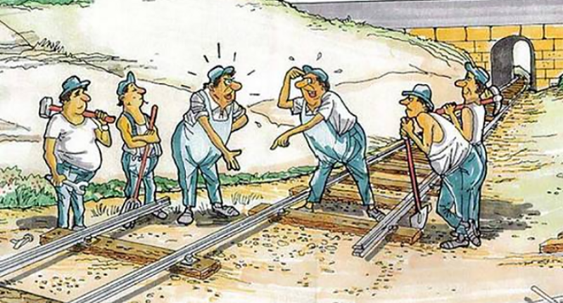

Slide 21
Only after the software architecture is complete does an Independent Test Group become involved.
The role of an Independent Test Group (ITG) is to remove the inherent problems associated with letting the builder test the thing that has been built. ITG removes the conflict of interest that may otherwise be present. After all, ITG personnel are paid to find errors.
However, you don’t turn the program over to ITG and walk away. The developer and the ITG work closely throughout a software project to ensure that thorough tests will be conducted. While testing is conducted, the developer must be available to correct errors that are uncovered.

Slide 22
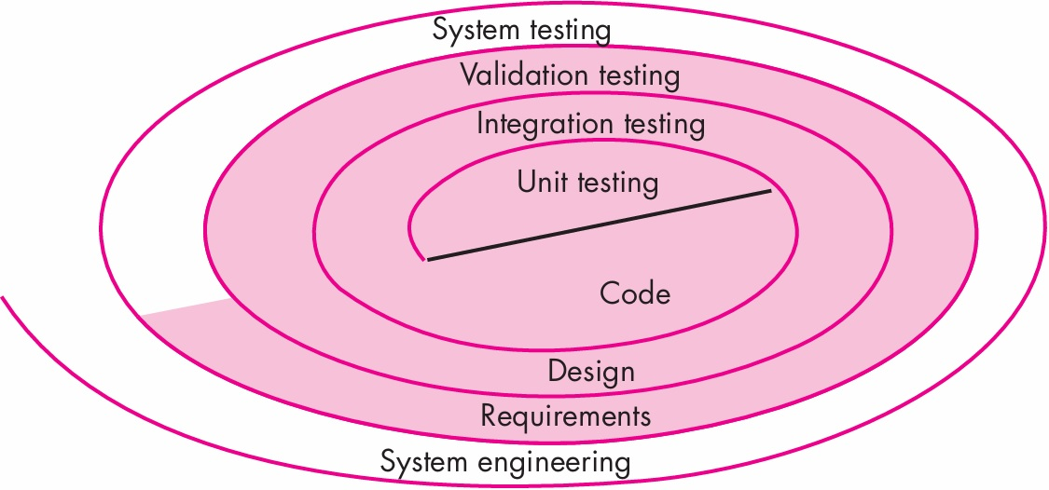
Software Testing Strategy—The Big Picture

Slide 23
A strategy for software testing may also be viewed in the context of the spiral.
Unit testing begins at the vortex of the spiral and concentrates on each unit of the software as implemented in source code.
Testing progresses by moving outward along the spiral to integration testing, where the focus is on design and the construction of the software architecture.
Taking another turn outward on the spiral, you encounter validation testing, where requirements established as part of requirements modeling are validated against the software that has been constructed.
Finally, you arrive at system testing, where the software and other system elements are tested as a whole.

Slide 24
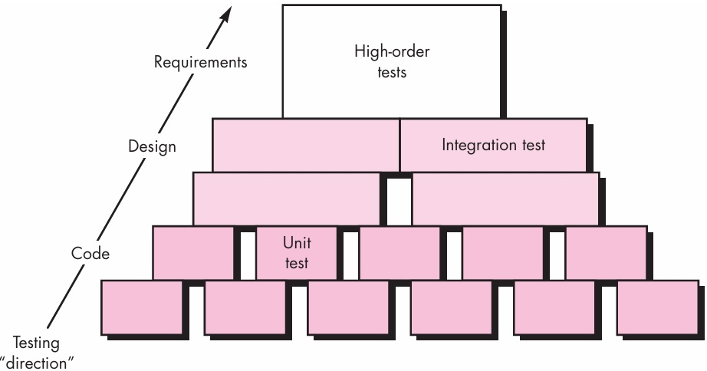
Considering the process from a procedural point of view, testing within the context of software engineering is actually a series of four steps that are implemented sequentially.

Slide 25
Test Strategies for Conventional Software
When to start testing?
There are many strategies that can be used to test software. At one extreme, you can wait until the system is fully constructed and then conduct tests on the overall system in hopes of finding errors. This approach, although appealing, simply does not work. It will result in buggy software that disappoints all stakeholders. At the other extreme, you could conduct tests on a daily basis, whenever any part of the system is constructed. This approach, although less appealing to many, can be very effective.

Slide 26
A testing strategy that is chosen by most software teams falls between the two extremes.
It takes an incremental view of testing, beginning with the testing of individual program units, moving to tests designed to facilitate the integration of the units, and culminating with tests that exercise the constructed system.
Each of these classes of tests is described in the sections that follow.

Slide 27
Unit Testing
Unit testing focuses verification effort on the smallest unit of software design—the software component or module. Using the component-level design description as a guide, important control paths are tested to uncover errors within the boundary of the module.
The unit test focuses on the internal processing logic and data structures within the boundaries of a module. Hence, all independent paths through the control structure are exercised to ensure that all statements in a module have been executed at least once. Boundary conditions are tested to ensure that the module operates properly at boundaries established to limit or restrict processing.
This type of testing can be conducted in parallel for multiple components.

Slide 28
Unit Testing
Most common errors
Misunderstood/incorrect arithmetic precedence
Incorrect initializations
Incorrect comparison of variables
Precision inaccuracy
Incorrect symbolic representation of an expression
Mixed mode operations
Unit testing is simplified when a component with high cohesion is designed.

Slide 29
Integration Testing
A neophyte in the software world might ask a seemingly legitimate question once all modules have been unit tested: “If they all work individually, why do you doubt that they’ll work when we put them together?”
The problem, of course, is “putting them together”—interfacing.
Data can be lost across an interface; one component can have an inadvertent, adverse effect on another; subfunctions, when combined, may not produce the desired major function; individually acceptable imprecision may be magnified to unacceptable levels (Shamsul Alamin Pharma); global data structures can present problems. Sadly, the list goes on and on.

Slide 30
Integration Testing
Top down
Bottom up
Top down or Bottom up?

Slide 31
Selection of integration testing strategy depends upon software characteristics and sometimes project schedule.
Sometimes a combined approach (sandwich testing) is used …

Slide 32
Cohesion and Coupling
Cohesion refers to how closely related the responsibilities of a single module or class are. A highly cohesive module performs a single, well-defined task, making it easier to understand, test, and maintain.
For example, a clsUserManager class that only handles user-related operations (like creating, updating, or deleting users) is cohesive.
High cohesion = focused, organized, and reusable code.
Low cohesion = scattered responsibilities, harder to maintain.

Slide 33
Cohesion and Coupling
Coupling describes how dependent one module is on another. Low coupling means modules interact through well-defined interfaces and don’t rely heavily on each other’s internal workings. This makes the system more flexible and easier to change.
Low coupling = modules can evolve independently.
High coupling = changes in one module may break others.
The sweet spot in software design is high cohesion and low coupling.

Slide 34
Regression testing (Toughest)
Each time a new module is added, the software changes. New data flow paths are established, new I/O may occur, and new control logic is invoked. These changes may cause problems with functions that previously worked flawlessly.
In the context of an integration test strategy, regression testing is the re-execution of some subset of tests that have already been conducted to ensure that changes have not propagated unintended side effects.

Slide 35
Sanity Testing
A sanity test is a narrow regression test that focuses on one or a few areas of functionality
Sanity testing is usually narrow and deep.
A Sanity test is used to determine a small (usually very critical/ Shamsul Alamin Pharma) section of the application (a few areas of functionality) is still working after a minor change.

Slide 36
Smoke testing
Smoke testing originates in the hardware testing practice of turning on a new piece of hardware for the first time and considering it a success if it does not catch fire and smoke.
In software industry, smoke testing is a shallow and wide approach whereby all areas of the application without getting into too deep, is tested.
It is scripted, either using a written set of tests or an automated test (selenium)
Smoke testing is conducted to ensure whether the functionalities of a program are conforming, but not bothering with finer details.
Smoke testing is like normal health check up.

Slide 37
Test Strategies for Object-Oriented Software
The objective of testing is to find out the greatest possible number of errors with a manageable amount of effort applied over realistic time span remains the same for Object Oriented Software.

Slide 38
Unit Testing in the OO Context
Class testing for OO software is the equivalent of unit testing for conventional software.
Unlike unit testing of conventional software, which tends to focus on the algorithmic detail of a module and the data that flow across the module interface, class testing for OO software is driven by what is the main characteristics that the class wants to assimilate, the operations encapsulated by the class and the state behavior of the class.

Slide 39
Integration Testing in the OO Context
There are two different strategies for integration testing of OO systems.
The first, thread-based testing, integrates the set of classes required to respond to one input or event for the system. Each thread is integrated and tested individually.
The second integration approach, use-based testing, begins the construction of the system by testing those classes (called independent classes) that use very few (if any) server classes. After the independent classes are tested, the next layer of classes, called dependent classes, that use the independent classes are tested. This sequence of testing layers of dependent classes continues till the end.
Cluster testing is one step in the integration testing of OO software. Here, a cluster of collaborating classes is exercised by designing test cases that attempt to uncover errors in the collaborations.

Slide 40
Validation Testing in an OO Context
From validation testing, the distinction between conventional and object-oriented software disappears.
After validation testing two possible conditions exist:
Conforms to specification and is accepted
A derivation from specification is uncovered and a deficiency list is created
Deviation or error discovered at this stage can rarely be corrected prior to scheduled delivery
Negotiation with customers… (?)

Slide 41
Validation Testing: How?
Alpha Testing
It is virtually impossible for a software developer to foresee how the customer will really use the program
The software is used in a natural setting with the developer “looking over the shoulder” of typical users and recording errors and usage problems
Takes relatively longer time (validates all requirements)
Conducted at developer’s site

Slide 42
Beta Testing
Conducted at end user’s site
Software is used like “live” application
Takes a bit long time (again validates all requirements)
Usually done by several group of users
Users report all the problems and those are compiled and corrected before final release

Slide 43
System Testing
Deployment Testing
Sometimes called configuration testing, exercises the software in different environment in which it is to operate
Security testing
Tester attempts to penetrate the system
Performance testing
Run-time performance
Stress testing
How high can the software handle before it fails
Recovery testing
Fault tolerant

Slide 44
Overall Test Characteristics
A good test has a high probability of finding errors
A good test is not redundant
Should be “best of breed”
“neither too simple nor too complex”

Slide 45
Debugging
Debugging occurs as a consequence of successful testing
Debugging sometimes pose greater challenge as the external manifestation of the error and the internal cause of the error may have no obvious relationship. (Shamsul Alamin Pharma)

Slide 46
Debugging Process
Debugging begins with the execution of the error generating test case …
Attempts to match the symptom with probable causes … thereby leading to error correction
Debugging will always have one of two outcomes
Cause will be found and corrected
Cause will not be found

Slide 47
Debugging -> more of psychological.
However, a few characteristics of bugs provide some clues:
The symptom of the case may be geographically remote. That is, the symptom may appear in one part of a program while the cause may actually be located at a site that is far remote. Highly coupled components exacerbate this situation.
The symptom may disappear when another error is corrected
The symptom may actually be caused by non errors (round-off problems)
It may be very difficult to reproduce the input conditions (in real-time situation)
The symptom may be intermittent (in embedded systems)

Slide 48
Psychological Considerations
During debugging, we encounter errors that range from mildly annoying to catastrophic.
As the consequence of an error increase, the amount of pressure to find the cause also increases.
Often, pressure forces a software developer to fix one more error while at the same time introducing two more
Unfortunately, there appears to be some evidence that debugging prowess is an innate human trait. Some are good at it and others aren’t.
Still, if somebody follows a good debugging strategy, they can show very good performance…

Slide 49
Debugging Strategies
Debugging has one very straightforward objective: to find and correct the cause of the error
Debugging strategies
Brute force
Backtracking
Cause elimination
Automated debugging: Integrated Development Environments (IDEs) provide a way to capture some of the language specific predetermined errors (e.g., missing end-of-statement characters, undefined variables, and so on) without requiring compilation.
The people factor: any discussion of debugging approaches and tools is incomplete without mention of a powerful ally—other people! A fresh viewpoint can do wonders. A final maxim for debugging might be: “When all else fails, get help!”

Slide 50
Correcting the Error
Once a bug has been found, it must be corrected. But, as we have already noted, the correction of a bug can introduce other errors and therefore do more harm than good.
Hence, after correcting the error, we need to go for Regression Testing…

Slide 51
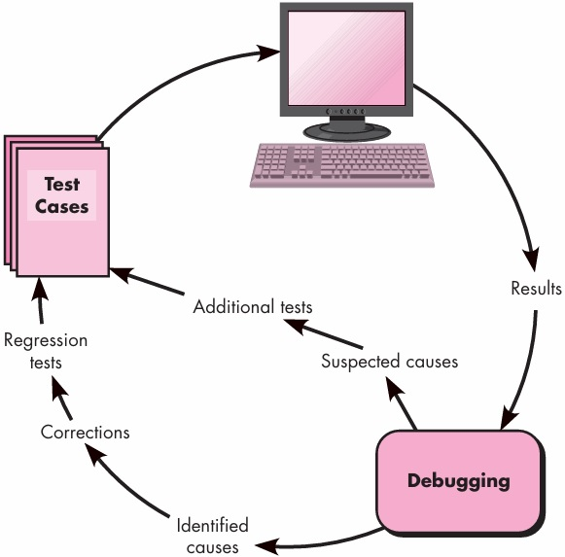

Slide 52
